Slide 1
Identifying interactive factors influencing quality antenatal care utilization in Bangladesh: Application of interpretable machine learning algorithm
8th International Conference on The Role of Statistics and Data Science in 4IR
Department of Statistics, University of Rajshahi, Bangladesh

Slide 2

Our team
Md. Ismail Hossain
Moumita Datta Gupta
Md. Mahfuzur Rahman
Department of Mathematics and Natural Sciences, BRAC University, Dhaka, Bangladesh

Slide 3
Outline
01
02
03
04
05
06
Background
Objectives
Methods
Results
Conclusions
Strengths & Limitations

Slide 4
01
Background

Slide 5
Background
Quality Antenatal Care (ANC) is important for maternal and neonatal health (Gamberini et al., 2022).
Many low- and middle-income countries, including Bangladesh, are working to reduce maternal and child mortality.
Ensuring four or more antenatal care (ANC) visits.
Utilizing trained service providers.
Improving the quality of prenatal health screenings.

Slide 6
Literature Gap
Despite efforts, quality ANC uptake remains low in Bangladesh (21.2%).
Very few studies on socioeconomic factors influencing quality ANC in Bangladesh (Rahman et al., 2017).
However, in real life, the effect is not limited to just one or a few factors; understanding interactions is equally important.
In Bangladesh, a study has been conducted on two-factor interactions (Akter et al., 2023), but a gap remains in addressing more complex scenarios.

Slide 7
02
Objectives

Slide 8
Objectives
Identify key factors influencing quality antenatal care utilization and their interactions using machine learning algorithms.
Explore how combinations of factors (interactions) influence the likelihood of utilizing quality antenatal care.

Slide 9
03
Methods

Slide 10
Data & Variables
Used national representative survey data, named Bangladesh Demographic and Health Survey (BDHS), 2022.
Focus: Women with live births in the last two years.
Sample Size: 3,549 reproductive-aged women.
Outcome variable of the study was utilizing Quality Antenatal Care.
Included 23 independent factors related to quality antenatal care, identified through a comprehensive literature review.

Slide 11
List of Independent Factors
Justified beating for unannounced outing
Justified beating for child neglect
Justified beating for marital disagreement
Justified beating for refusal of intemency
Justified beating for food mishap
Women’s age (in years)
Women’s education
Husband’s education
Women’s working status
Husband’s working status
Age at first marriage
Age at first birth
Birth order
Pregnancy intention
Institutional delivery
Access distance to healthcare
Health facility permission
Financial access to treatment
Sex of household head
Religion
Residence
Region
Mass media
Wealth status
Early ANC intention

Slide 12
Analytical Process
Random Forest Algorithm
Rank important of factors
Identify key factors
Generate rule-based interactions between factors
Decision Tree Algorithm
Logistic Regression
Comprehensive understanding of relationship
Evaluate statistical significance of interactions

Slide 13
04
Results

Slide 14
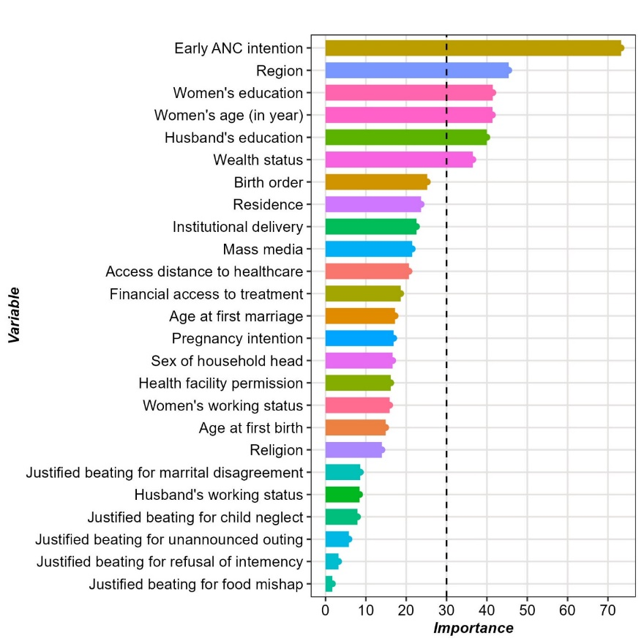
Fig 1: Important factors
Early ANC Intention
Region
Women’s education
Women’s age
Husband’s education
Wealth status

Slide 15
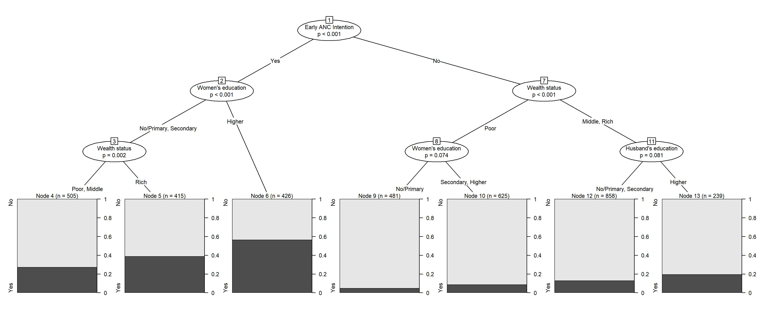
Fig 2: Rule-based Interaction

Slide 16
Proportion of interactions
Rule ID | Rule combination | QANC %
Node 4 | EANC = Yes & WEDU = No/Primary or Secondary & WEALTH = Poor or Middle | 27.3
Node 5 | EANC = Yes & WEDU = No/Primary or Secondary & WEALTH = Rich | 38.8
Node 6 | EANC = Yes & WEDU = Higher | 56.6
Node 9 | EANC = No & WEALTH = Poor & WEDU = No/Primary | 4.8
Node 10 | EANC = No & WEALTH = Poor & WEDU = Secondary or Higher | 8.8
Node 12 | EANC = No & WEALTH = Middle or Rich & HEDU = No/Primary or Secondary | 12.9
Node 13 | EANC = No & WEALTH = Middle or Rich & HEDU = Higher | 19.7

Slide 17
Impact of rule-based interactions
Nodes | aOR | 95% CI | P value
Node 4 | 1.54 | 1.06, 2.25 | 0.03
Node 5 | 2.59 | 1.79, 3.80 | <0.001
Node 6 | 5.32 | 3.69, 7.79 | <0.001
Node 9 | 0.21 | 0.12, 0.34 | <0.001
Node 10 | 0.39 | 0.26, 0.60 | <0.001
Node 12 | 0.61 | 0.42, 0.89 | 0.009

Slide 18
05
Strengths & Limitations

Slide 19
Strengths
Utilized advanced machine learning techniques to identify key factors influencing quality antenatal care.
Focused on nationally representative data, enhancing generalizability across diverse sociodemographic groups in Bangladesh.

Slide 20
Limitations
Wide confidence intervals for interaction terms.
Cross-sectional design limits causality.

Slide 21
06
Conclusions

Slide 22
Conclusions
Early ANC intention, women’s education, and wealth status are key determinants of quality antenatal care, requiring focused interventions.
Addressing educational and socioeconomic disparities can bridge the care quality gap, improving maternal and child health outcomes.
Understanding interactions can inform policymakers about how certain interventions (e.g., financial support) work only in specific contexts.

Slide 23
Abbreviations
QANC = Quality Antenatal Care
EANC = Early ANC Intention
WEALTH = Wealth Status
WEDU = Women’s Education
HEDU = Husband’s Education

Slide 24
References
Akter, E., Hossain, A. T., Rahman, A. E., Ahmed, A., Tahsina, T., Tanwi, T. S., … Chowdhury, M. E. (2023). Levels and determinants of quality antenatal care in Bangladesh: Evidence from the Bangladesh Demographic and Health Survey. PLOS ONE, 18(5), e0269767.
Gamberini, C., Angeli, F., & Ambrosino, E. (2022). Exploring solutions to improve antenatal care in resource-limited settings: An expert consultation. BMC Pregnancy and Childbirth, 22(449), 1–11.
Rahman, A., Nisha, M. K., Begum, T., Ahmed, S., Alam, N., & Anwar, I. (2017). Trends, determinants and inequities of 4+ ANC utilisation in Bangladesh. Journal of Health, Population and Nutrition, 36(2), 8.

Slide 25
Thanks!!!
Do you have any questions?
ext.ismail.hossain@bracu.ac.bd

